Slide 1
Handshake Supervisor Training
Presented by The Career Development Center

Slide 2

Today’s Agenda
Creating a Handshake Account
Posting a Job in Handshake
Accessing your Applicants
Expiring and Duplicating Job postings
Handshake Support and Resources

Slide 3
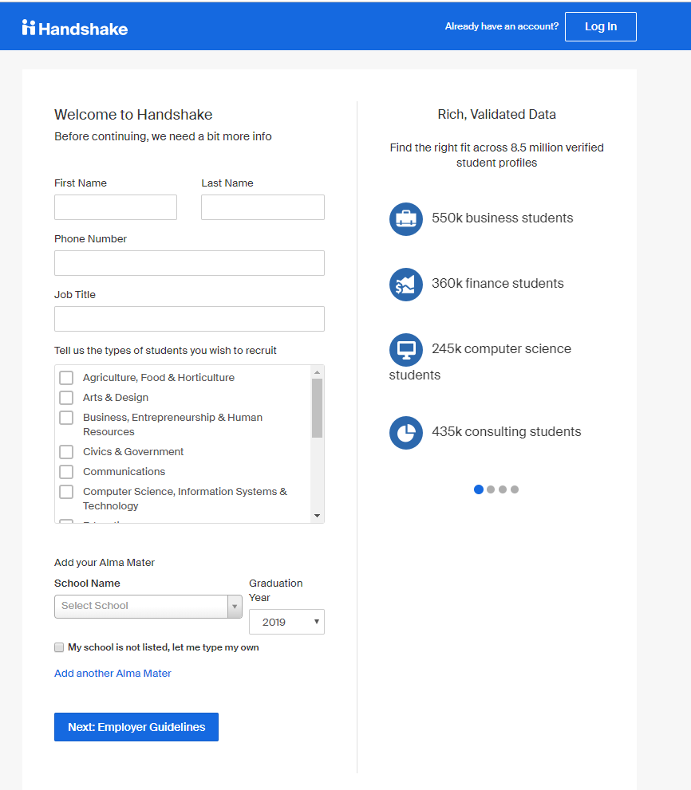
How to Create a Handshake Account pt. 1
Go to Handshake:
  app.joinhandshake.com/employer_registrations/new
Make sure you use your UTA email.
  Single Sign On IS NOT supported for faculty/staff Handshake accounts.
Fill in your name, phone number, job title, the type of students you want to hire, and where you graduated from.

Slide 4
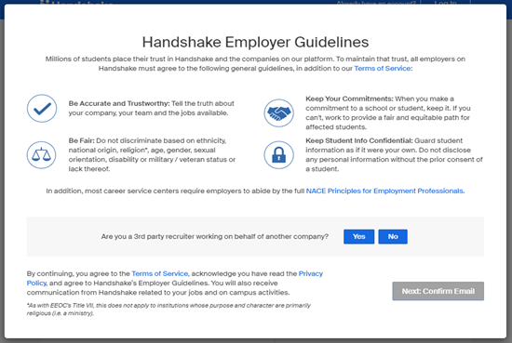
How to Create a Handshake Account pt. 2
Handshake will ask if you are a third-party recruiter.
  Answer “No.”
Confirm your email. You will receive an email from Handshake to confirm your account. This can take 10 minutes. Make sure you check your spam!

Slide 5
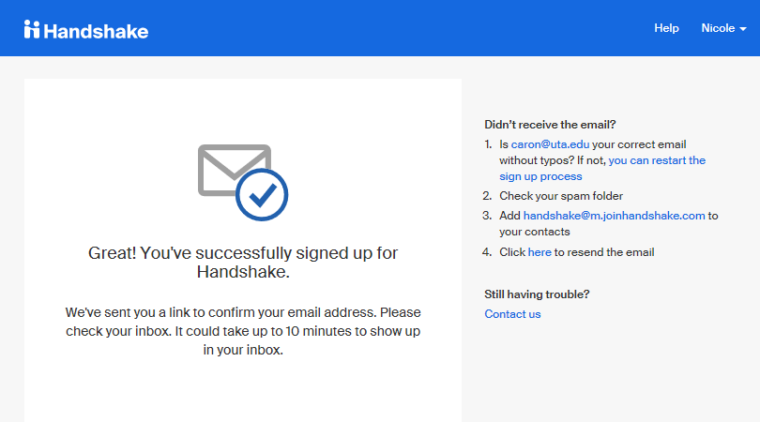
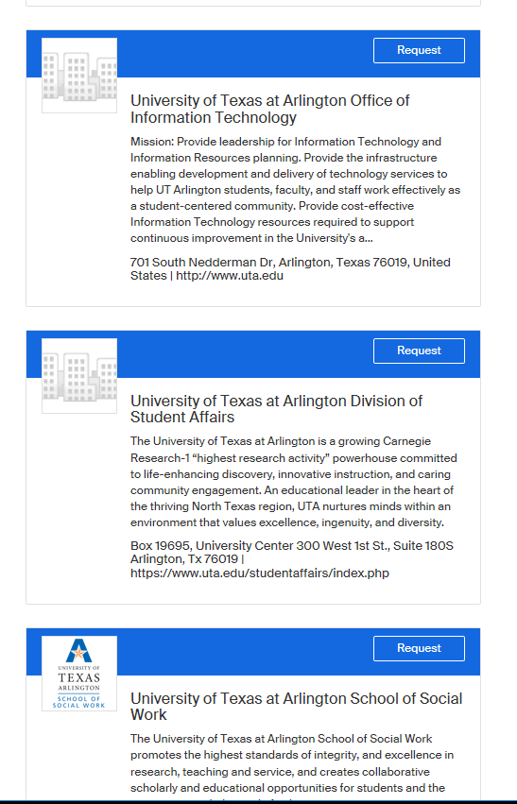
How to Create a Handshake Account pt. 3
Once your account is confirmed, request access to your department.
  Every department is listed as “University of Texas at Arlington Department Name.”
  The Career Development Center has made a landing page for each department on campus.
  *NOTE* If your department has previously used Handshake, your department owner will have to approve your request. Owners are typically admins or someone who typically posts jobs for your department.

Slide 6
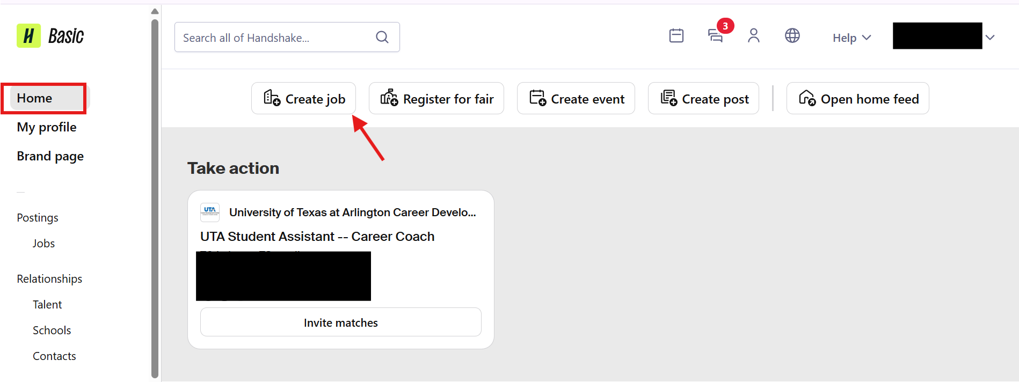
How to Post a Job in Handshake pt. 1
To log in to your account, go to: app.joinhandshake.com
  For an employer account, you CANNOT use single sign on.
Start by clicking ’Create job’ from your home dashboard or clicking on ‘Home’ in the left-hand navigation bar.

Slide 7
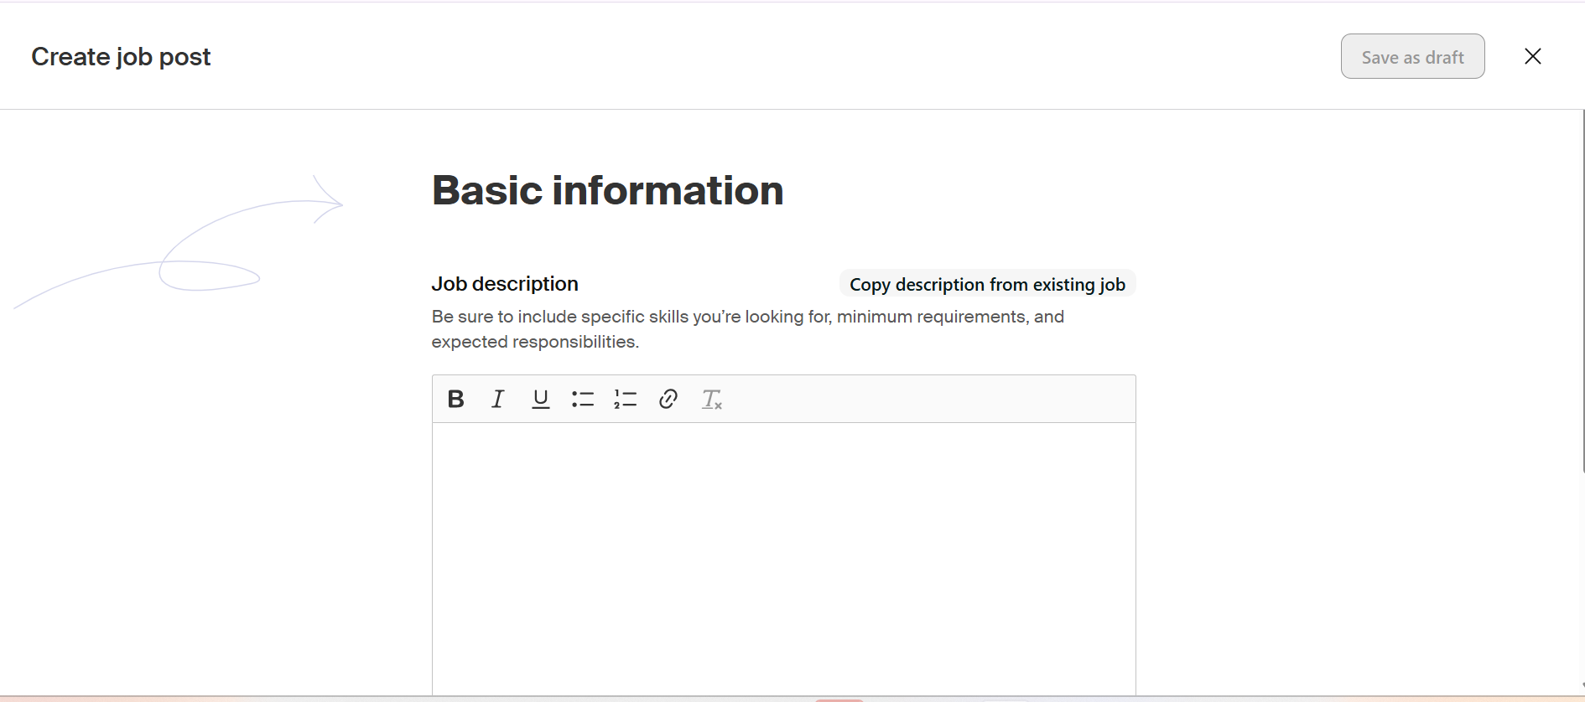
How to Post a Job in Handshake pt. 2
Please provide a basic description of the type of job you want to hire students for. Your job description must include job duties, responsibilities, and necessary qualifications. There’s also a helpful check option that allows Handshake to use your information to automatically fill in the remaining details.
Notes:
Please always include "UTA" in the front of all job positions. If it is work-study, please make it a habit to include "UTA Work-Study" at the front of the job title.
If your Job Type is incorrectly marked as any other type, Student Employment will not know as we do not have access to the additional job type queues. Therefore, your job posting will be pending until your department notifies us that it has not been reviewed.
Although Student Employment does not provide job descriptions, we can offer tips and suggestions that will help make your job postings stand out:
Embrace Clarity and Detail: Be crystal clear about the role's responsibilities, qualifications, and what sets your department apart. Students are hungry for information, so provide a comprehensive overview that showcases the exciting challenges they'll tackle and the impact they'll make.
Speak Their Language: Appeal to students by adopting a conversational tone that resonates with their aspirations. Address them directly, showcasing how their skills and fresh perspectives will be valued in your dynamic work environment.
Showcase Growth Opportunities: Highlight the growth potential within your department. Students are eager to learn and advance, so emphasize the learning opportunities, mentorship, and potential career paths that await them.
Spotlight Impactful Projects: Feature some of your most innovative projects that students can be a part of. Showcasing real-world applications of their potential contributions will ignite their passion and drive to join your team.
Champion Your Company Culture: Emphasize your department's unique culture and values. Students seek inclusive and supportive environments, so illustrate how your workplace fosters collaboration, creativity, and a sense of belonging.
Be Authentic: Let your department's personality shine through. Students are attracted to authenticity, so don't be afraid to share stories that demonstrate the incredible experiences your current team members have had.
Offer Flexibility and Perks: Flexibility and perks can make your role irresistible. Students appreciate employers who value work-life balance and offer remote options.
Inspire a Greater Purpose: Demonstrate the positive impact your organization makes on the world. Students are eager to contribute to causes that matter, so show how your company is making a difference and how they can be a part of it.
Encourage Creativity and Initiative: Empower students by expressing your openness to their unique ideas and solutions. Showcase that their creativity and initiative will be celebrated and rewarded.
Personalize Your Job Descriptions: Tailor your job descriptions to different roles and audiences. Craft specific descriptions that address the aspirations and interests of students in various fields.
By following these tips, you can show students that your department is not just a place to work but an inspiring journey where they can learn, grow, and make their mark.

Slide 8
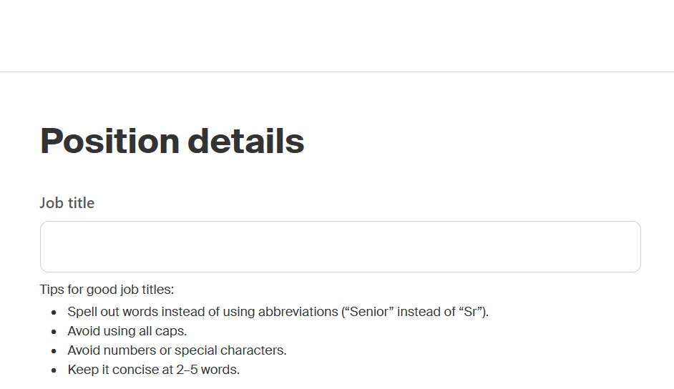
How to Post a Job in Handshake pt. 3
Job Title : All job titles should include the following naming:
    UTA Student Assistant – Working Title
      Example: UTA Student Assistant – Marketing Intern
    UTA Work-Study Student Assistant – Working Title
      Example: UTA Work-Study Student Assistant – Front Desk
Notes:
Please always include "UTA" in the front of all job positions. If it is work-study, please make it a habit to include "UTA Work-Study" at the front of the job title.
If your Job Type is incorrectly marked as any other type, Student Employment will not know as we do not have access to the additional job type queues. Therefore, your job posting will be pending until your department notifies us that it has not been reviewed.
Although Student Employment does not provide job descriptions, we can offer tips and suggestions that will help make your job postings stand out:
Embrace Clarity and Detail: Be crystal clear about the role's responsibilities, qualifications, and what sets your department apart. Students are hungry for information, so provide a comprehensive overview that showcases the exciting challenges they'll tackle and the impact they'll make.
Speak Their Language: Appeal to students by adopting a conversational tone that resonates with their aspirations. Address them directly, showcasing how their skills and fresh perspectives will be valued in your dynamic work environment.
Showcase Growth Opportunities: Highlight the growth potential within your department. Students are eager to learn and advance, so emphasize the learning opportunities, mentorship, and potential career paths that await them.
Spotlight Impactful Projects: Feature some of your most innovative projects that students can be a part of. Showcasing real-world applications of their potential contributions will ignite their passion and drive to join your team.
Champion Your Company Culture: Emphasize your department's unique culture and values. Students seek inclusive and supportive environments, so illustrate how your workplace fosters collaboration, creativity, and a sense of belonging.
Be Authentic: Let your department's personality shine through. Students are attracted to authenticity, so don't be afraid to share stories that demonstrate the incredible experiences your current team members have had.
Offer Flexibility and Perks: Flexibility and perks can make your role irresistible. Students appreciate employers who value work-life balance and offer remote options.
Inspire a Greater Purpose: Demonstrate the positive impact your organization makes on the world. Students are eager to contribute to causes that matter, so show how your company is making a difference and how they can be a part of it.
Encourage Creativity and Initiative: Empower students by expressing your openness to their unique ideas and solutions. Showcase that their creativity and initiative will be celebrated and rewarded.
Personalize Your Job Descriptions: Tailor your job descriptions to different roles and audiences. Craft specific descriptions that address the aspirations and interests of students in various fields.
By following these tips, you can show students that your department is not just a place to work but an inspiring journey where they can learn, grow, and make their mark.

Slide 9
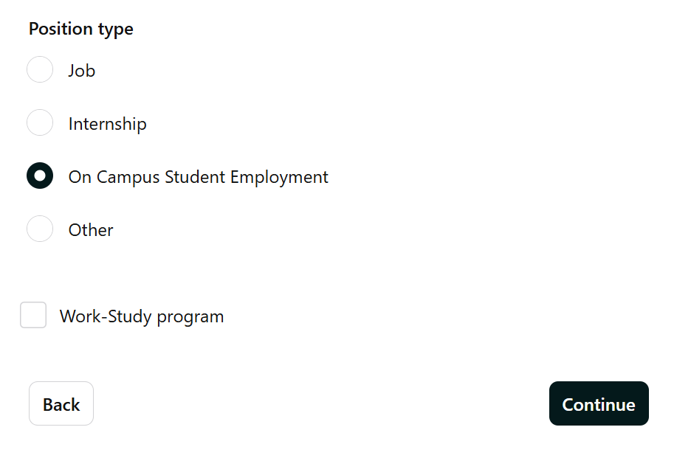
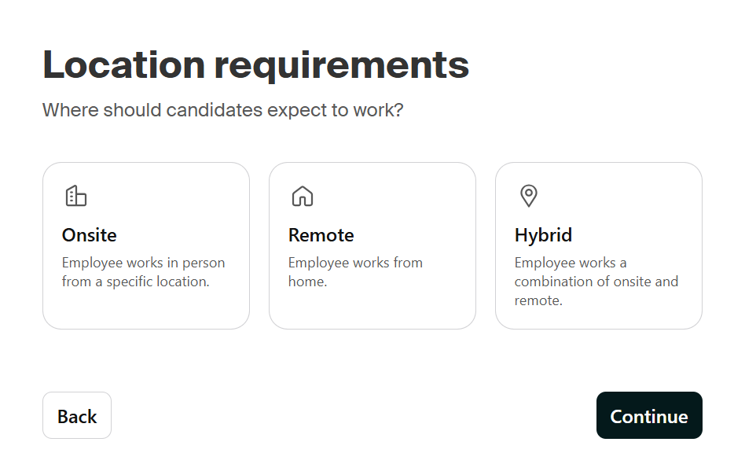
How to Post a Job in Handshake pt. 4
Position Type: Always select "On Campus Student Employment"
Federal Work-Study Program Box: By checking the box, only students eligible for work-study can see the position. By not checking the box, all students can see the position.
Location: Please select whether your position is available onsite, remote, or hybrid. For onsite location, please type in "Arlington, TX" for your location.
Notes:
Please always include "UTA" in the front of all job positions. If it is work-study, please make it a habit to include "UTA Work-Study" at the front of the job title.
If your Job Type is incorrectly marked as any other type, Student Employment will not know as we do not have access to the additional job type queues. Therefore, your job posting will be pending until your department notifies us that it has not been reviewed.
Although Student Employment does not provide job descriptions, we can offer tips and suggestions that will help make your job postings stand out:
Embrace Clarity and Detail: Be crystal clear about the role's responsibilities, qualifications, and what sets your department apart. Students are hungry for information, so provide a comprehensive overview that showcases the exciting challenges they'll tackle and the impact they'll make.
Speak Their Language: Appeal to students by adopting a conversational tone that resonates with their aspirations. Address them directly, showcasing how their skills and fresh perspectives will be valued in your dynamic work environment.
Showcase Growth Opportunities: Highlight the growth potential within your department. Students are eager to learn and advance, so emphasize the learning opportunities, mentorship, and potential career paths that await them.
Spotlight Impactful Projects: Feature some of your most innovative projects that students can be a part of. Showcasing real-world applications of their potential contributions will ignite their passion and drive to join your team.
Champion Your Company Culture: Emphasize your department's unique culture and values. Students seek inclusive and supportive environments, so illustrate how your workplace fosters collaboration, creativity, and a sense of belonging.
Be Authentic: Let your department's personality shine through. Students are attracted to authenticity, so don't be afraid to share stories that demonstrate the incredible experiences your current team members have had.
Offer Flexibility and Perks: Flexibility and perks can make your role irresistible. Students appreciate employers who value work-life balance and offer remote options.
Inspire a Greater Purpose: Demonstrate the positive impact your organization makes on the world. Students are eager to contribute to causes that matter, so show how your company is making a difference and how they can be a part of it.
Encourage Creativity and Initiative: Empower students by expressing your openness to their unique ideas and solutions. Showcase that their creativity and initiative will be celebrated and rewarded.
Personalize Your Job Descriptions: Tailor your job descriptions to different roles and audiences. Craft specific descriptions that address the aspirations and interests of students in various fields.
By following these tips, you can show students that your department is not just a place to work but an inspiring journey where they can learn, grow, and make their mark.

Slide 10
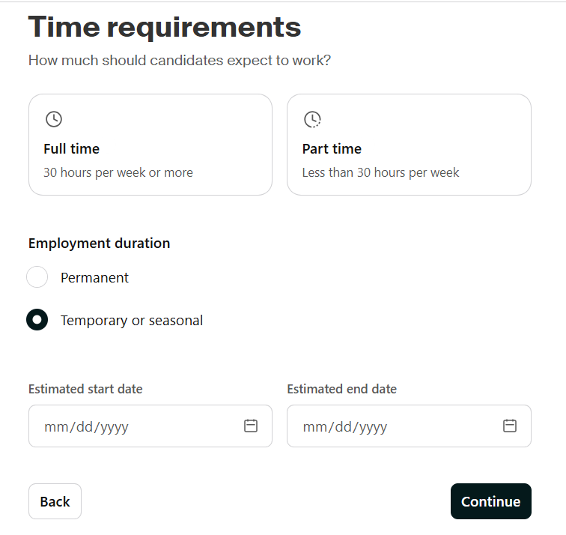
How to Post a Job in Handshake pt. 5
Time Requirements
  All student employment positions are part-time, and students are only eligible to work up to 19 hours per week.
Employment Duration
  Always select “temporary or seasonal.”
  The estimated start and end date is dependent on the department.
Notes:
Employment Duration – As positions are temporary, departments have the choice to have a student work for the academic year and/or semester by semester, depending on their work performance.

Slide 11
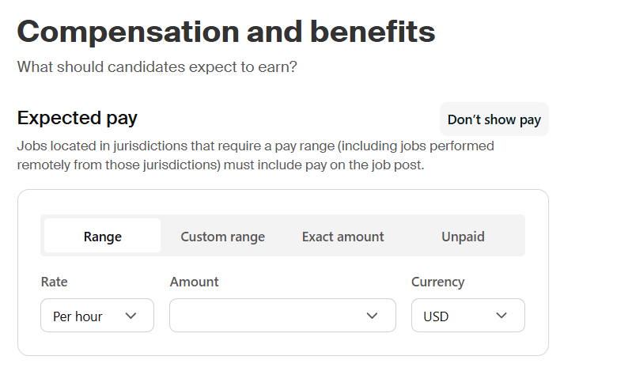
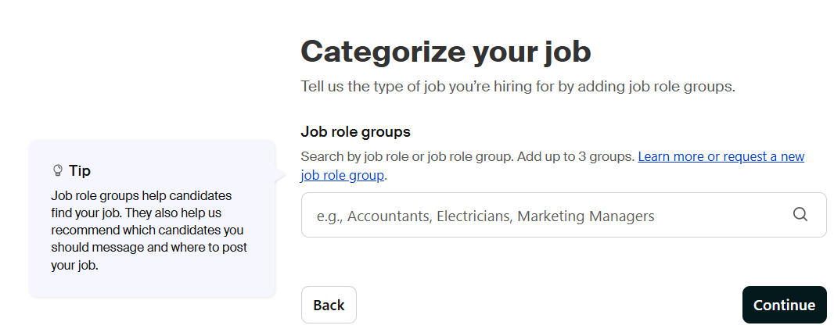
How to Post a Job in Handshake pt. 6
Compensation
It is required for pay to be listed on all job positions, whether a range or an exact amount.
Preferences are optional
  School Years
  Graduation Date Range
Major Groups
  You can pick specific majors
Minimum GPA
Notes:
Employment Duration – As positions are temporary, departments have the choice to have a student work for the academic year and/or semester by semester, depending on their work performance.

Slide 12
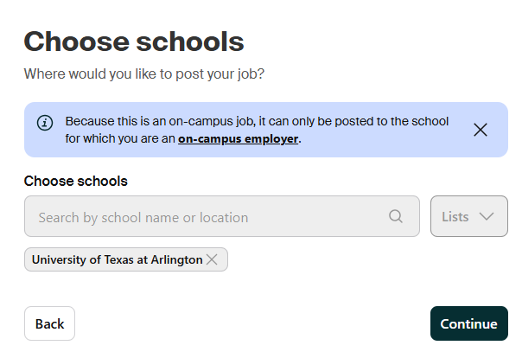
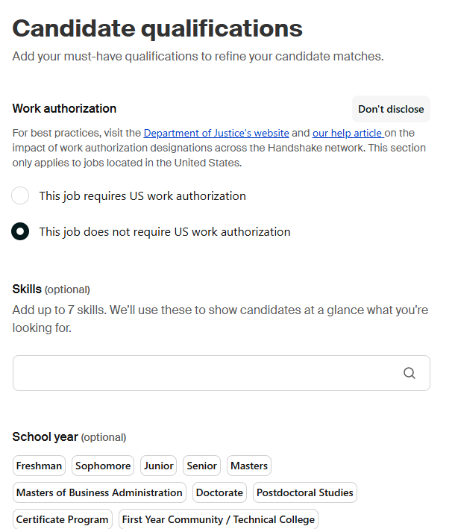
How to Post a Job in Handshake pt. 7
Add your job posting to the University of Texas at Arlington.
Choose how long you want your job posted by setting a date range.
  minimum 5 days
  maximum 30 days

Slide 13
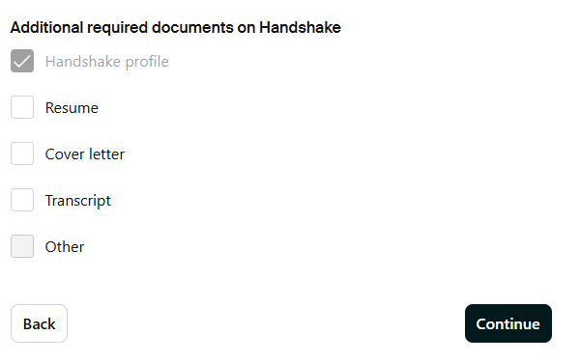
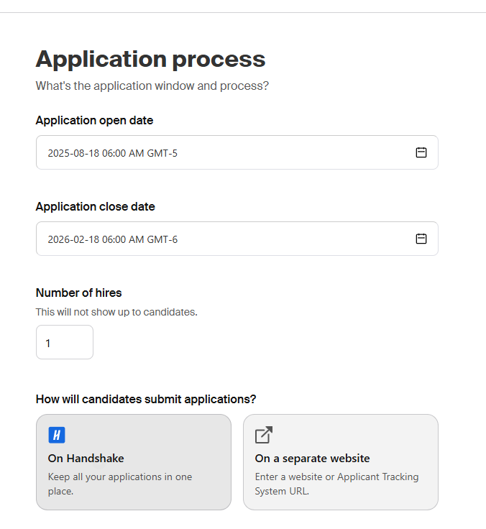
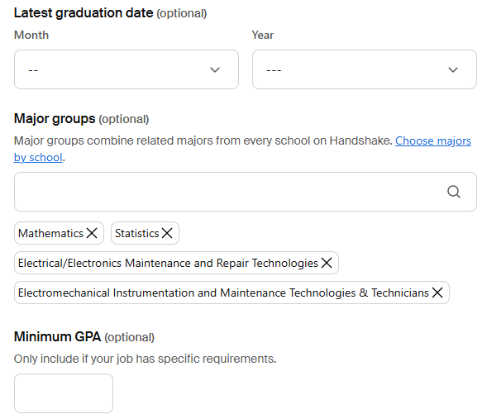
How to Post a Job in Handshake pt. 8
Include the number of hires you need.
Applications can be submitted via Handshake or an external website of your choosing.
Request for additional documents, if needed.

Slide 14
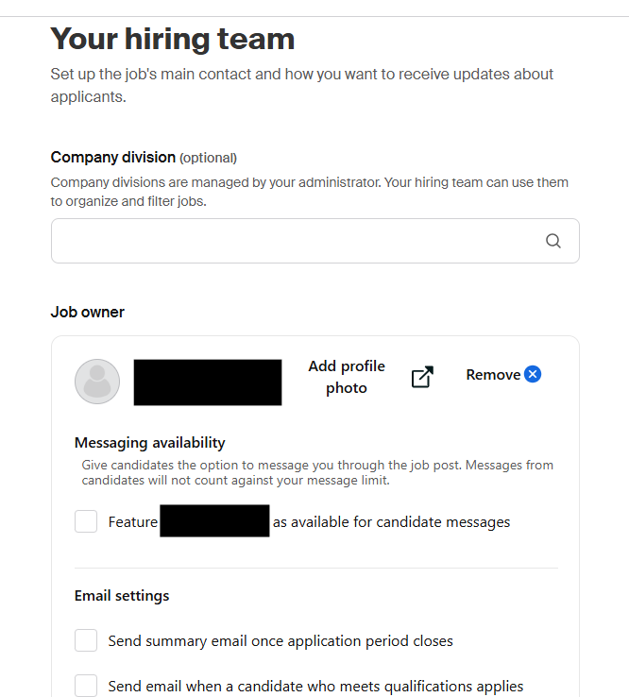
How to Post a Job in Handshake pt. 9
When posting a job, you are the designated contact who can receive emails on who has applied to your job posting.
You can also include additional contacts.
Once completed, you have the option to review your job posting before posting it.
Once posted, you will receive an email confirmation when Student Employment has approved your job posting.
Notes:
Student Employment can take 24-48 hours to approve a job posting. If you need immediate assistance, please do not hesitate to reach out to us.

Slide 15
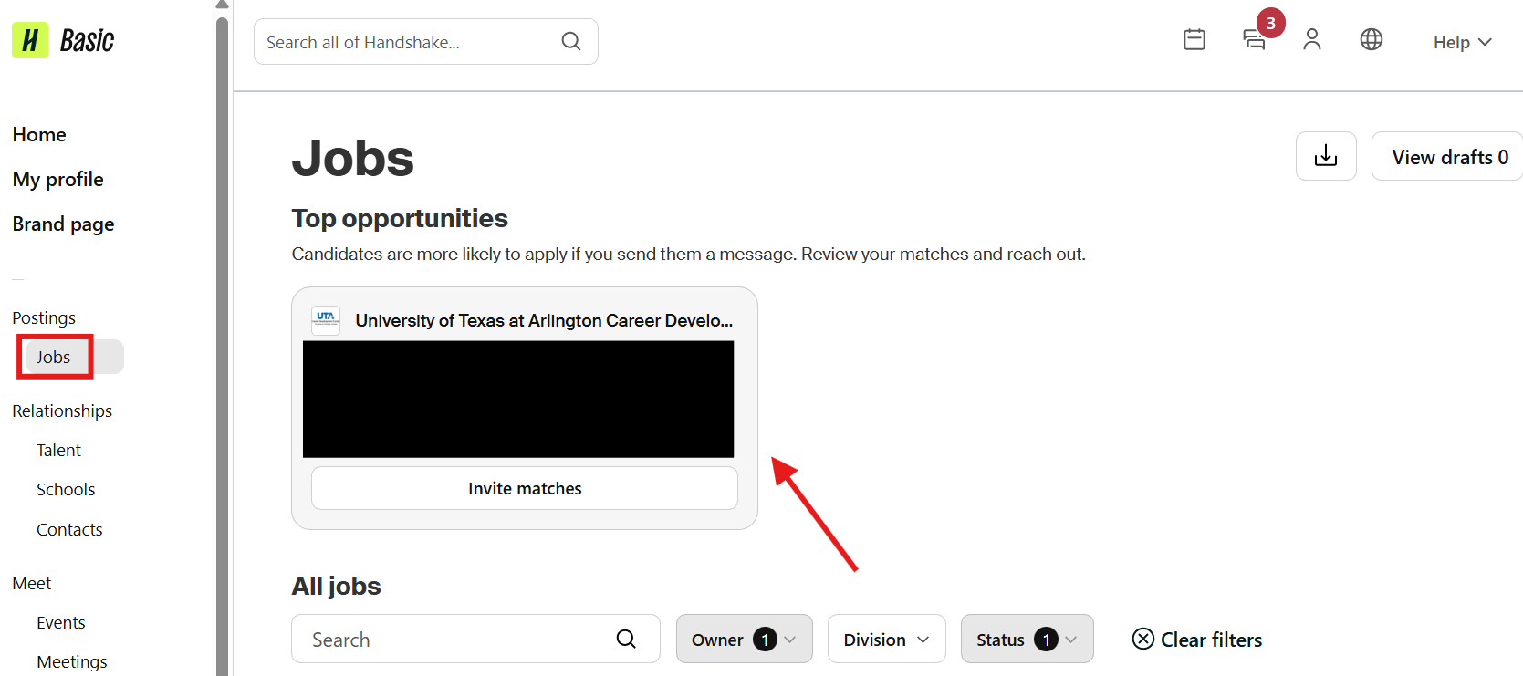
Accessing your Applicants pt. 1
To log in to your account, go to: app.joinhandshake.com
  For an employer account, you CANNOT use single sign on.
Once you are logged in, Click “Jobs” in the left-hand navigation bar.
Locate the job you’d like to view applicants for.
  Click on the job that’s listed to review your applicants.

Slide 16
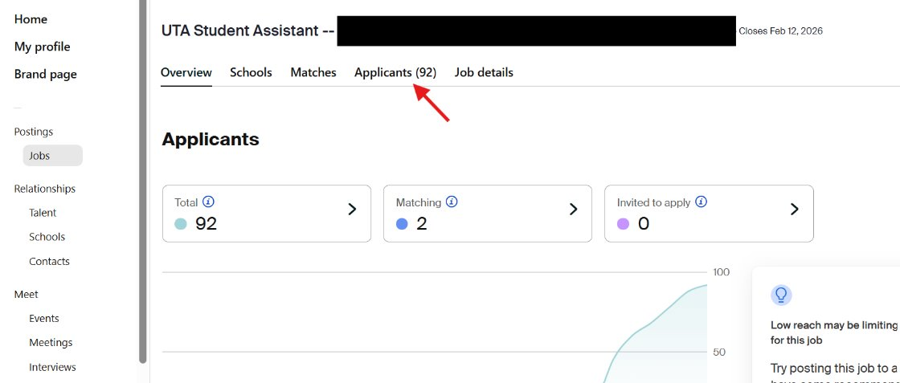
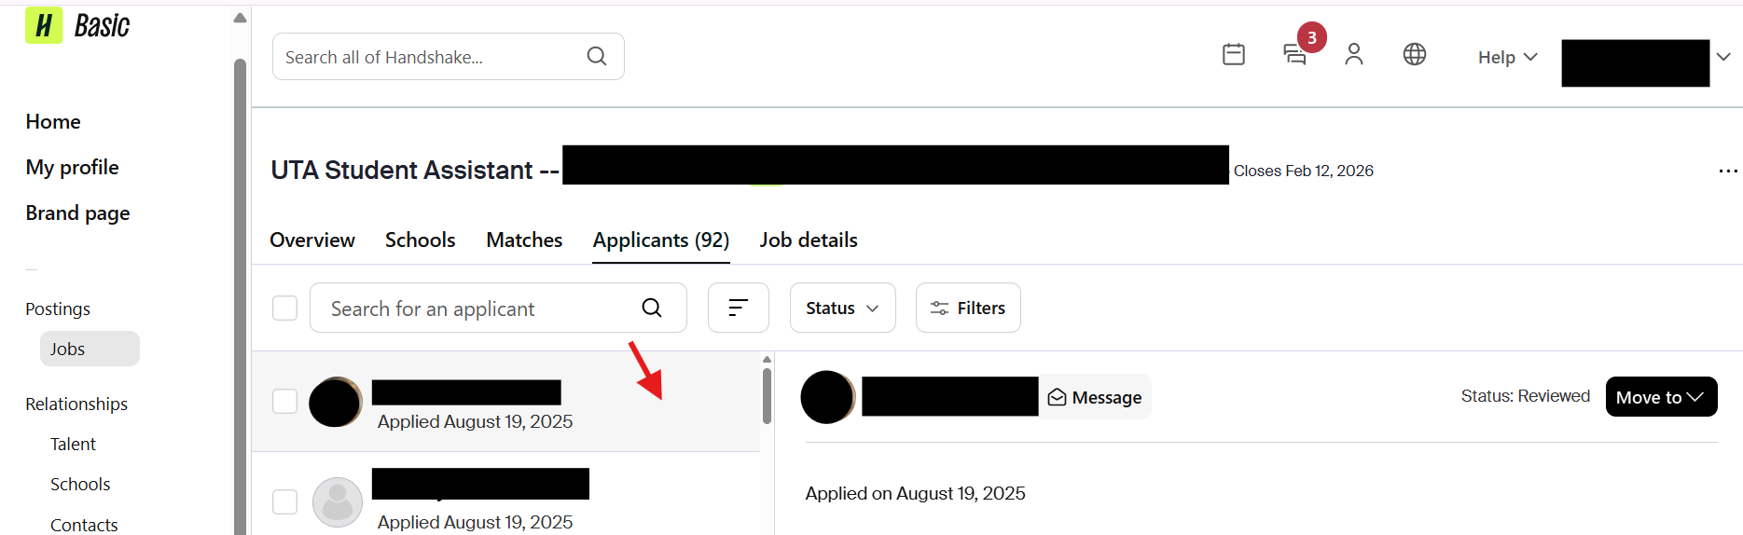
Accessing your Applicants pt. 2
Once the page loads, you will be brought directly to the “Applicants” page for your specific job posting.
By clicking on ”the applicant’s name”, you can access their Handshake profile and application documents.
You can also download an Excel sheet or a document packet with all the applicant’s resumes or required documents.

Slide 17
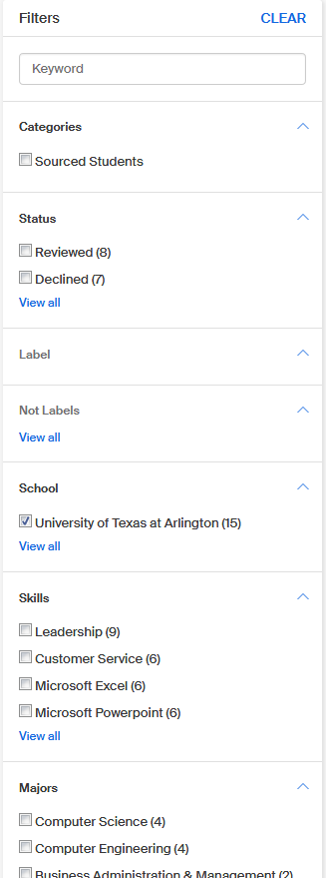
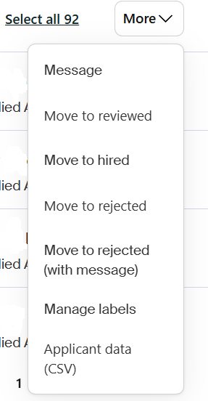
Accessing your Applicant pt. 3
By selecting all students, you can message all applicants, or add a label.
You can use filters to sort by different categories for different skillsets.
You can also download an Excel sheet or a document packet with all the applicant’s resumes or required documents.

Slide 18
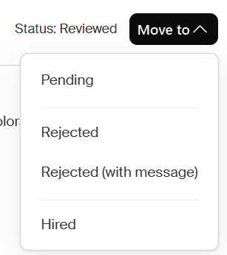
Close a Posting pt. 1
Once you have hired your student(s), please change the hired student's status to “hired” and decline the remaining applicants. ​
You can decline applicants individually or as a group if you aren’t going to hire them. (This lets the student know they aren’t moving forward in the hiring process.) If you are hiring a student, please mark them as hired. Todo this, change their status.
Navigate to the job posting -> “Applicants” -> Select the Applicant -> Click on "Move to"​ dropdown menu

Slide 19
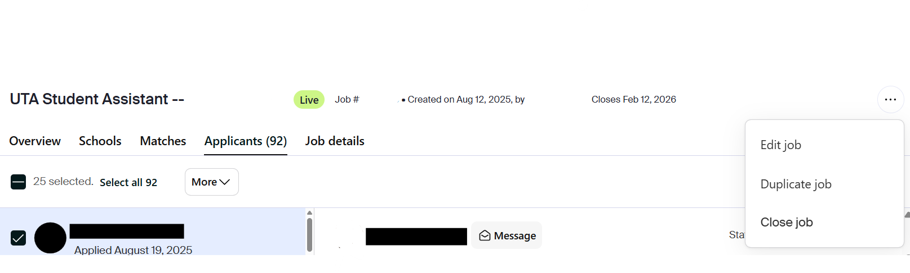
Close the Posting pt. 2
Close the job posting once you have filled the position.​
This prevents new applicants from applying and getting lost in the process.​
Select the job you wish to expire -> three dots at the top right-hand corner -> “Close Job”​

Slide 20
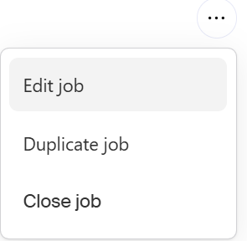
Duplicating a Job Posting pt. 1
Log into Handshake and select “Jobs” on the left side pane or if you see it on your screen click that as well.​
Once you select the job your screen will look like the screenshot below.
From here, select the three dots at the top right-hand corner, and then it will drop down to show different action items.
You will select ”Duplicate Job”.
Notes:
We encourage departments to please do not reset job postings. For best practices, please expire your job posting, then duplicate for up to 30 days to receive a fresh applicant pool. If you are hesitant to do this because previous applicants may reapply, be sure to download your candidate pool report so that you are able to deny those applications you are not interested in.

Slide 21

Handshake Support & Resources
If you find that you need more Handshake resources or to submit a support ticket on Handshake, be sure to visit their help center.
Go to https://support.joinhandshake.com/hc/en-us
Select “Contact Support” or click on the message icon shown in the image below to submit a support ticket.
Notes:
While Student Employment oversees Handshake for UTA, there are certain aspects of the platform that we cannot directly edit. In specific cases such as transferring ownership when a Handshake account owner is no longer with UTA, removing a previous employee from one department to another, or deleting a Handshake account, you need to submit Handshake Support Tickets for assistance. If you encounter any difficulties while submitting your ticket, please feel free to contact Student Employment for further assistance.

Slide 22

Contact Us
Location: E.H. Hereford University Center, Suite 180S
Office Hours: Monday - Friday 8:00 am - 5:00 pm
Phone: 817-272-2932
Email: studentemployment@uta.edu
Website: www.uta.edu/careers
Handshake Website: uta.joinhandshake.com

